Slide 1
Sofware Engineering
Topic:
The mechanics of structured analysis-Data dictionary

Slide 2
Importance of DFDs in a good software design
The main reason why the DFD technique is so popular is probably because of the fact that DFD is a very simple formalism
It is simple to understand and use.
Starting with a set of high-level functions that a system performs,
A DFD model read-number validate-number data-item number valid-number hierarchically represents various sub-functions.

Slide 3
Data Dictionary
A structured place to keep details of the contents of data flows, processes, and data store.
It is a structured repository of data about data.
It is a set of definitions of all DFD elements

Slide 4
Continued…
For example, a data dictionary entry may represent that the data grossPay consists of the components regularPay and overtimePay.
grossPay = regularPay + overtimePay

Slide 5
Composite data items can be defined in terms of primitive data items using the following data definition operators:
+: denotes composition of two data items, e.g. a+b represents data a and b.
[,,]: represents selection, i.e. any one of the data items listed in the brackets can occur. For example, [a,b] represents either a occurs or b occurs.

Slide 6
Continued…
(): the contents inside the bracket represent optional data which may or may not appear.
e.g. a+(b) represents either a occurs or a+b occurs.
{}: represents iterative data definition,
e.g. {name}5 represents five name data.
{name}* represents zero or more instances of name data.

Slide 7
Continued…
=: represents equivalence,
e.g. a=b+c
means that a represents b and c.
/* */: Anything appearing within /* and */ is considered as a comment.

Slide 8
Advantages of Data Dictionary
Documentation- it is a valuable reference in any organization.
It improves analyst/user communication by establishing consistent definitions of various elements, terms and procedures
It is important step in building a database

Slide 9
Items to be defined in Data Dictionary
Data Elements- smallest unit of data that provides for no further decomposition.
For example: date consists of day, month and year
Data Structure- a group of data elements handled as a unit.
For example: phone is a data structure consisting of four data elements: area-code-exchange-number-extension.
Data Flows and Data Stores- data flows are data structures in motion, whereas data stores are data structures at rest. A data store is a location where data structures are temporarily located.

Slide 10
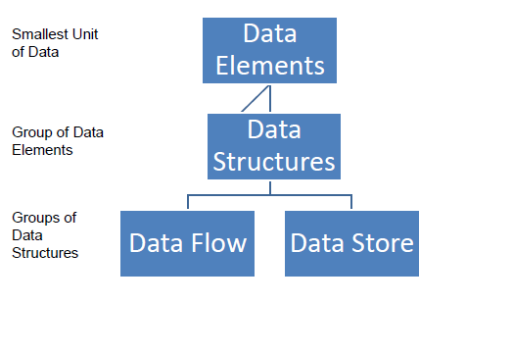
Data Dictionary Architecture:

Slide 11
Data Elements:
For e.g.
Author Name:
First
Middle
Last Alias
The Description of Data Element should include:
1.Name
2.Description &
3.An Alias (Synonym)

Slide 12
Data Elements has Control Information
–Such as Source, Date of Origin, Users, or Access Authorization.
For e.g. Looking for Properties of Word Doc.
Also has Physical Location
–In terms of Record of File or Database.
For e.g. Where Storage is done C Drive,
D Drive, CD ROM etc.

Slide 13
Importance of data dictionary
A data dictionary plays a very important role in any software development process because of the following reasons:
A data dictionary provides a standard terminology for all relevant data for use by the engineers working in a project.
A consistent vocabulary for data items is very important, since in large projects different engineers of the project have a tendency to use different terms to refer to the same data, which unnecessary causes confusion.

Slide 14
Conclusion:
The data dictionary provides the analyst with a means to determine the definition of different data structures in terms of their component elements.

